Slide 1

Home Prices Data Analysis
Aleksandr Savenko – Thinkful Data Immersion Cohort 8
Notes:
Hello! My name is Aleksandr Savenko and I’m a student at Thinkful Data Immersion Cohort 8

Slide 2
Introduction
Overview of Data about house pricing for multiple decades
Key Insights, Decision-Making Steps
Ho: μ1 - μ2 = 0,
Ha: μ1 - μ2 ≠ 0
Notes:
Today I'm going to speak about Data on housing prices for multiple decades. My goal was to investigate data, wrangle it, test it with the different hypotheses, find important insights, and make final decisions about parameters for investing. In this dataset, we have different variables which include standard built year, sqft of different areas, district, type of houses, rate but also more specific like foundation or roof style. First of all, I checked the data of the sales column for bias with the purpose to use it in my analysis. Then I made a basic analysis of data for first insights and finally, I made 4 hypotheses for making conclusions. I need to explain what hypotheses are here. For example, we take data with 2 parameters but with the same variable for comparison. How many people bought houses with this one type of roof and with another one. Our goal is to compare means to see the existence of difference or not. We have a p-value which is one of the most important numbers because it shows the percentage of answers that helps us to choose the answer. It must be less than 5 percent (alpha value) to confirm the difference because the other 95% values will be in a normal distribution. It’s a range with minimum outliers.

Slide 3
Testing Data for Bias Compared means of two samples Samples had similar means which indicates the samples are unbiased and good to use
Notes:
In this slide, I used the same method as for hypotheses. It’s called a t-test. We compare the mean and our p-value to alpha (5%). I divided the same data into 2 ranges and compared them. The mean is very close and the p-value bigger than alpha that means that our data the same and its null hypothesis( very small difference). We can use this data for investigation.

Slide 4
Data Analysis
Median: $180,921
Minimum: $34,900
Maximum: $755,000
Sum: $ 264 Millions
Count of data: 1460
Notes:
Now we have something more interesting. Here you can see data distribution which shows us a count of different average prices all over the data. The average of all data is 180 Thousand but we also know that the most frequent prices start from 100 to 240 Thousand. The company can make different calculations based on the median price.

Slide 5
Data Analysis
Median: 1512 Sqft
Minimum: 334 Sqft
Maximum: 5462 Sqft
Sum: 2,212,577 Sqft
Count of data: 1460
Notes:
This one is also interesting for the company because here you can see the average square footage of all houses which is 1500 sqft. We also know that the most frequent data starts from 1000 to 2000. We can use it as a parameter for investing because these houses are easier to sell.

Slide 6
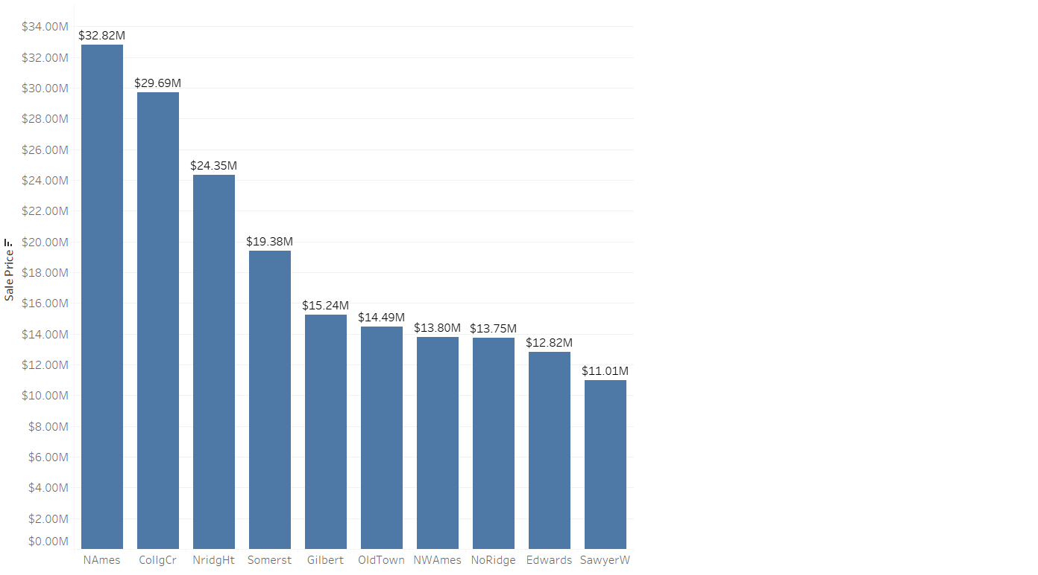
Data Analysis
Sum of Sales by Neighborhood - Top 10
Notes:
This slide shows the most interesting neighborhood for buying and selling homes. You can see the name and the full amount of sales.

Slide 7
Hypotheses
Mean:
185,943$ vs 179,026$
Sales Sum:
74M vs 189M
P-value: 0,14
Observations:
400 vs 1060
Notes:
Now I’m going to speak about the hypothesis. The first one is the number of sales during the cold months (September, October, November, December, January, and February) and hot months (March, April, May, June, July, and August) I need to say that its failed hypothesis because means don’t have really big difference but its important knowledge because we see that sum of s

Slide 8
Hypotheses
Mean:
175,985$ vs 210,052$
Observations:
726 vs 445
Sales Sum:
127M vs 93M
P-value:
2.39E-11
Notes:
In this slide, I compared sales for 1 story homes and second-story homes. It’s one of three confirmed hypotheses that we have a mean difference. So, now we know that it’s a bigger mean for 2 story homes and still big numbers of sales. It sounds interesting for investing.

Slide 9
Hypotheses
Mean:
162,588$ vs 306,491$
Observations:
1274 vs 186
Sales sum:
207M vs 57M
P-value:
1.74E-43
Notes:
This is the second confirmed hypothesis about the mean difference. I compared homes with 0-2 cars capacity and homes with 3-4 cars capacity. We have data that mean bigger houses are also big but it’s not too many values. So it’s better to invest in homes with 0-2 cars compacity because it’s easier to sell.

Slide 10
Hypotheses
Mean:
140,384$ vs 248,385$
Observations:
912 vs 548
Sales sum:
128M vs 136M
P-value:
1.91E-116
Notes:
The final hypothesis says us about the means of average rate houses and good quality houses. I divided it into 1-6 and 7-10 grade range homes. The company has enough data to invest in good quality homes because we can sell them at a bigger price. These decisions were made on the Sum of sales amount and mean value.

Slide 11
Final decisions
Invest in Homes between 850 and 2500 Sqft
Sell Homes preferably during summer months
Invest in 2 Story homes
Invest in homes with 0-2 car garages
Invest in homes with good ratings
Notes:
Here you can see final decisions from all data investigating. First, we have an sqft range of investing. Next, it’s valuable to sell homes during the summer. Other ones are buying 2 story homes with small garages and good rating and condition.

Slide 12

Thank you for your attention!

